Slide 1
Lecture 29-09-2020
Real world problems

Slide 2
Previously
We discussed many architectures
and showed how/why they work,
and how to build them with pytoch

Slide 3
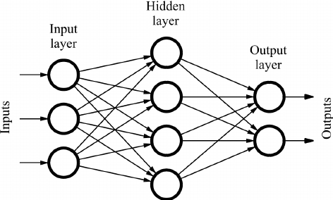
Fully connected neural network (MLP)
https://www.researchgate.net/figure/Sample-of-a-feed-forward-neural-network_fig1_234055177

Slide 4

ConvNets
https://towardsdatascience.com/a-comprehensive-guide-to-convolutional-neural-networks-the-eli5-way-3bd2b1164a53

Slide 5
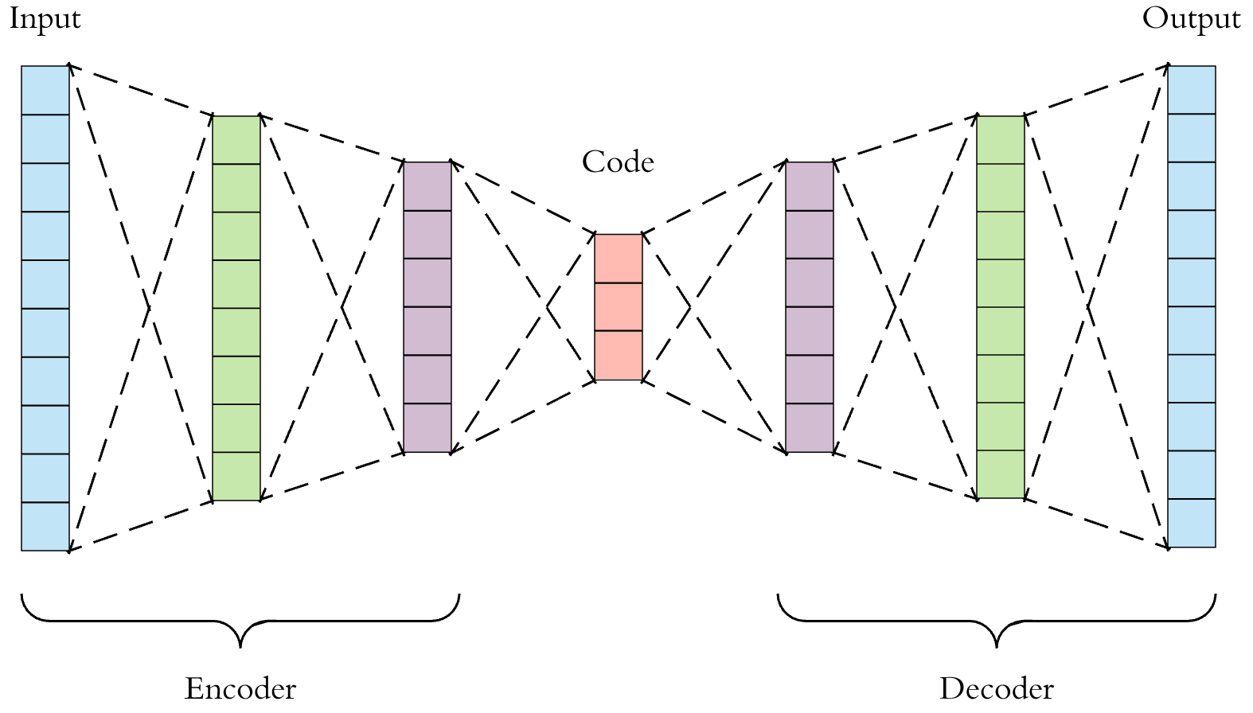
Auto encoder
https://towardsdatascience.com/applied-deep-learning-part-3-autoencoders-1c083af4d798

Slide 6
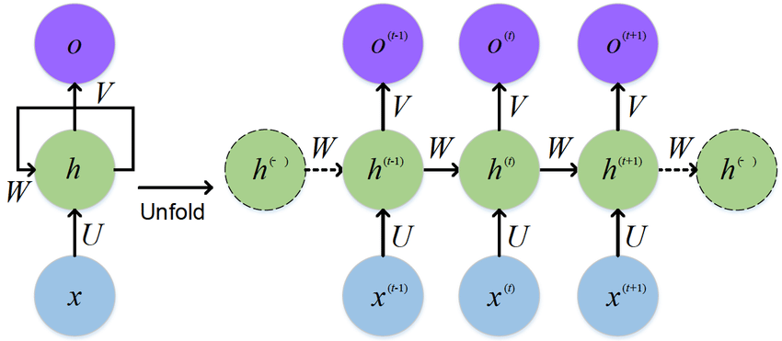
RNN
https://www.researchgate.net/figure/The-standard-RNN-and-unfolded-RNN_fig1_318332317

Slide 7
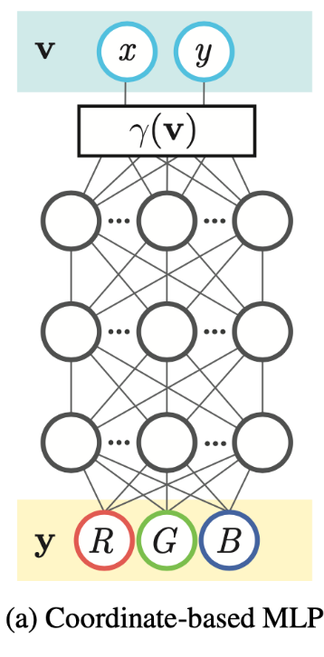
Coordinate based MLP

Slide 8
And other tricks...
- Dropout
- Residual Nets, with skip connections
- etc...

Slide 9
To the real world
- Many powerful deep learning architectures
- Are they applicable to all ‘real world’ problems?
- Or, is there still some engineering needed?
- During the presentation: I will show one ‘new’ architecture used in 2 different papers

Slide 10
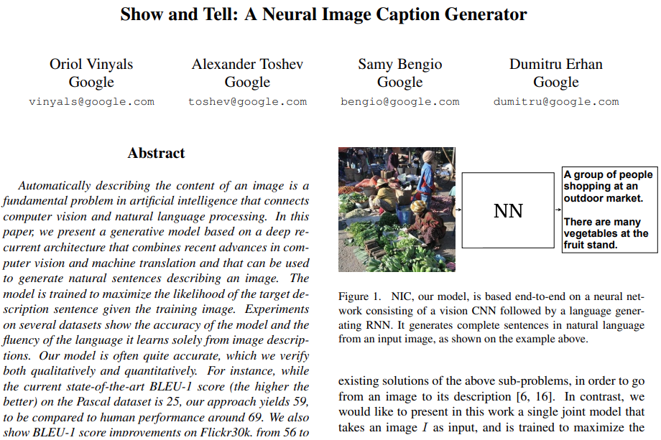
Paper (2015)
https://arxiv.org/pdf/1411.4555.pdf

Slide 11
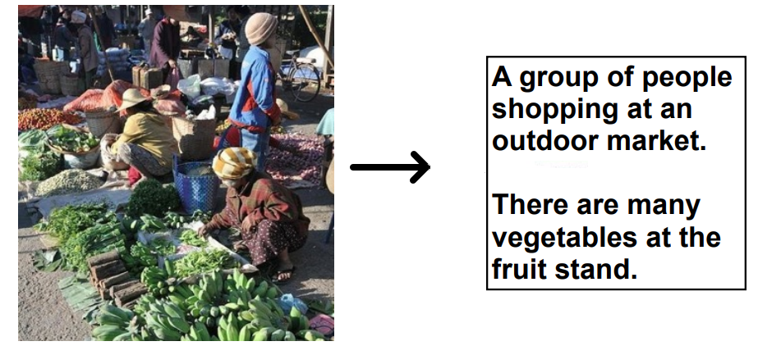
Problem to solve:

Slide 12
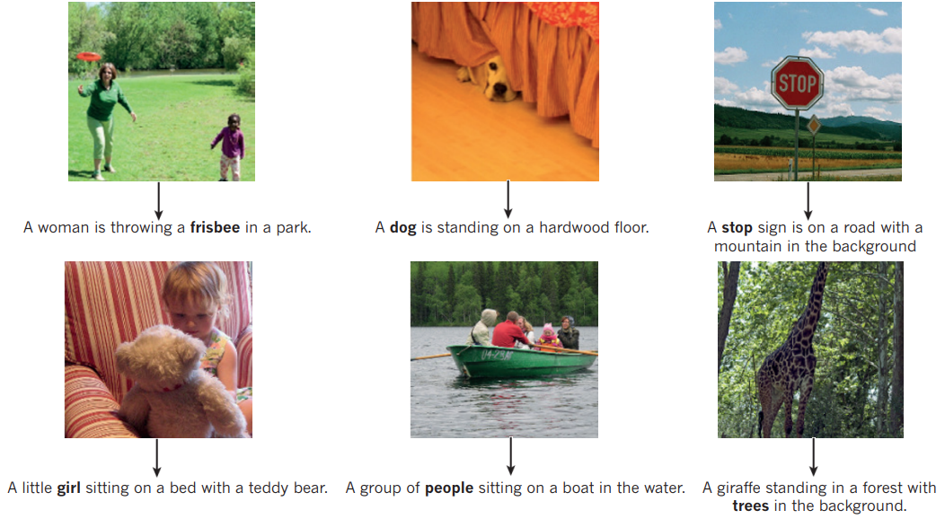
Problem, image inp → text out

Slide 13
How would you solve it?

Slide 14
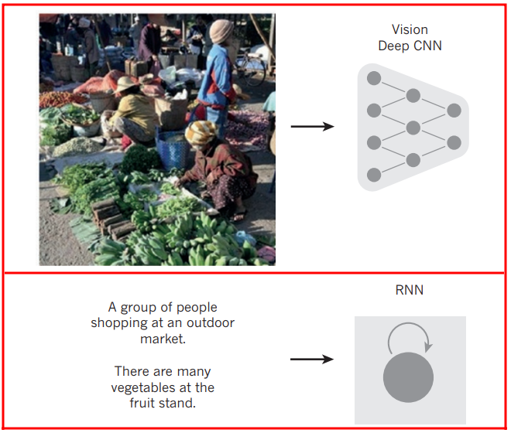
Problem

Slide 15
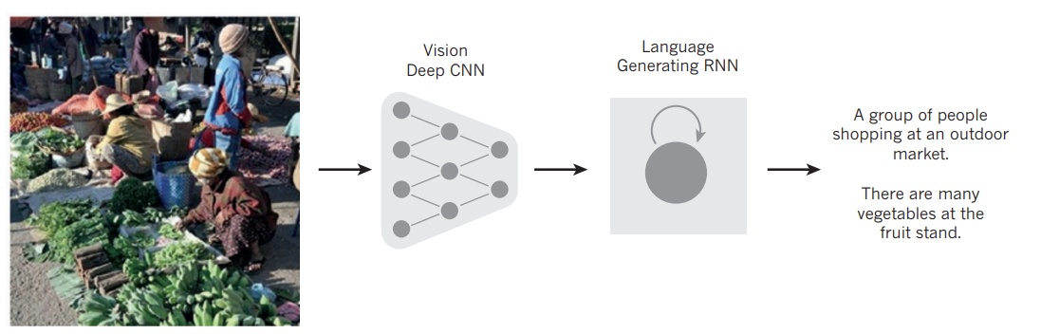
Solution

Slide 16
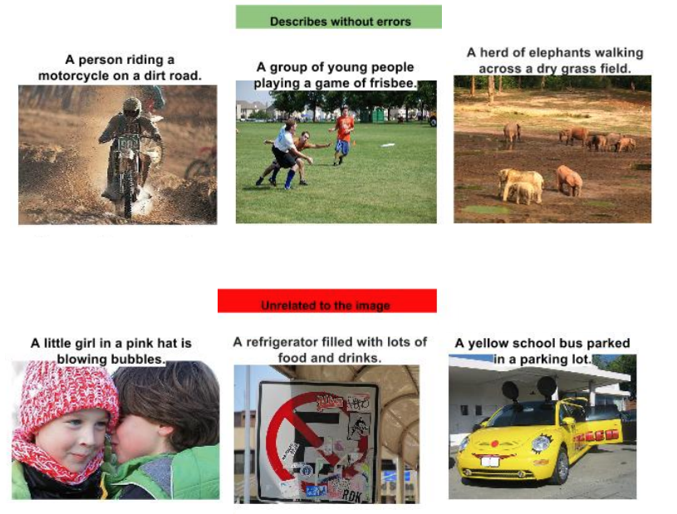
Results

Slide 17
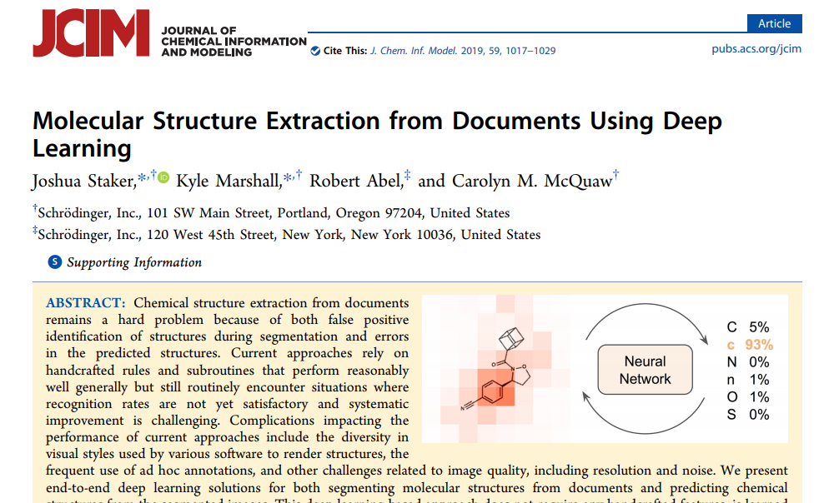
Other paper (2019)

Slide 18
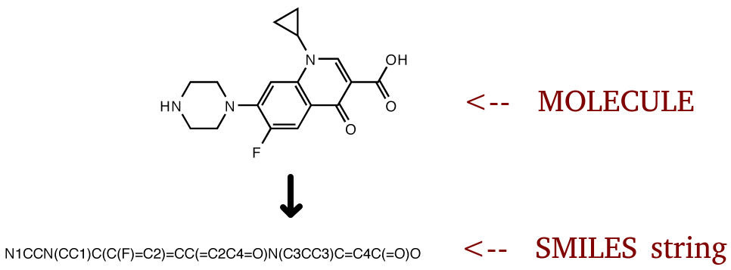
Optical structure recognition

Slide 19
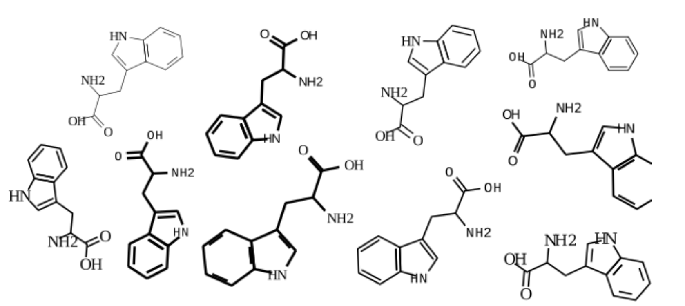
Many different drawing styles
Classic machine learning approaches fail

Slide 20
Other paper (2019)

Slide 21
Similar problem

Slide 22
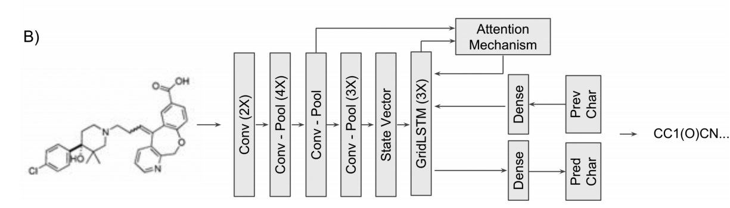

Slide 23
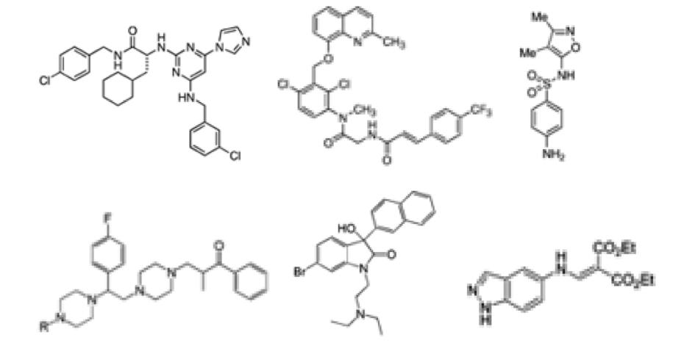
Results

Slide 24
Good idea
Good idea, but one fundamental flaw..

Slide 25
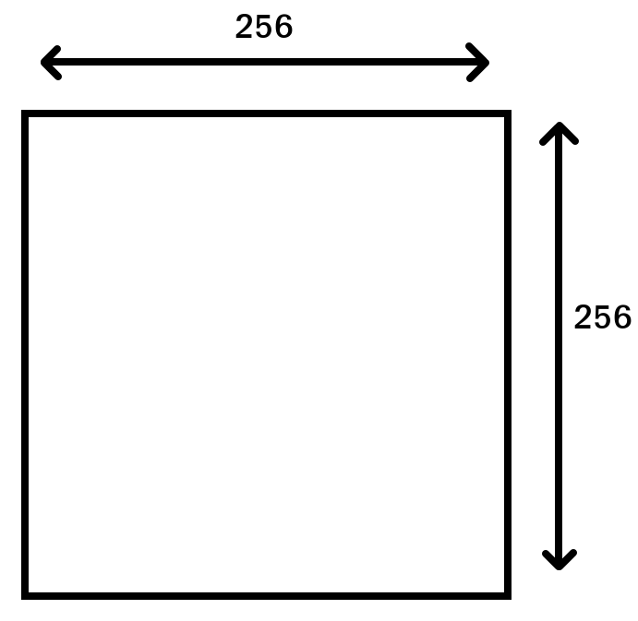
Fixed size input
RNNs need fixed size input
So, to acomplish that the
Input should also have a
Fixed size input:
Staker etal. chose 256 x 256
Pixels input and scaled
Images accordingly

Slide 26
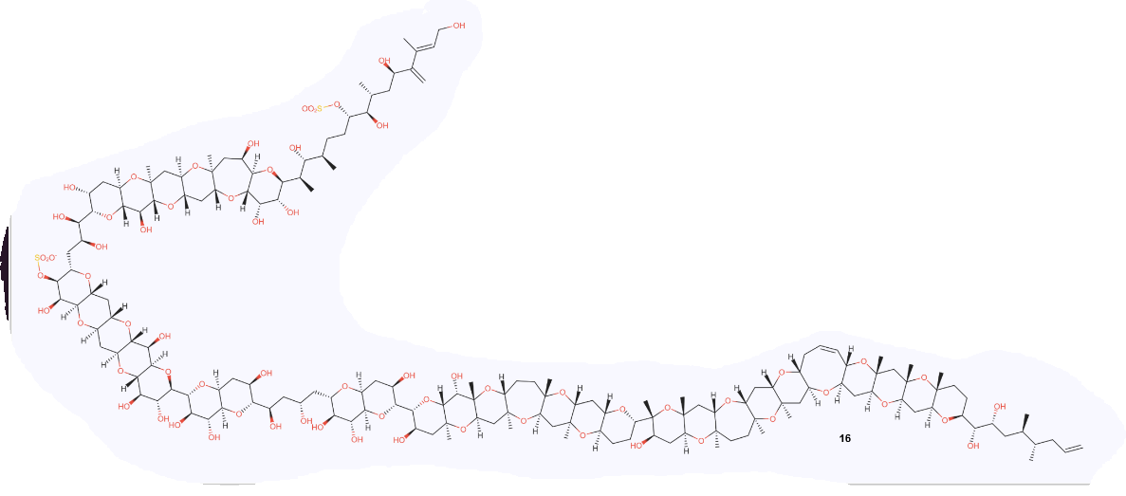
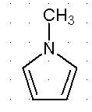
Fine for smaller molecules but...

Slide 27
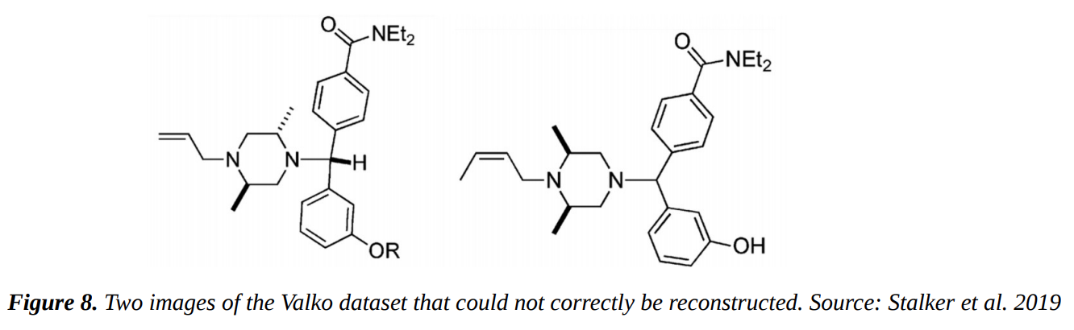
Also...
Despite trained on MILLIONS of examples, it still failed on many very very simple cases...

Slide 28
Another approach
But, there are more approaches to achieve a goal…
Staker et al. Only used the SMILES strings as labels, given generated molecules

Slide 29
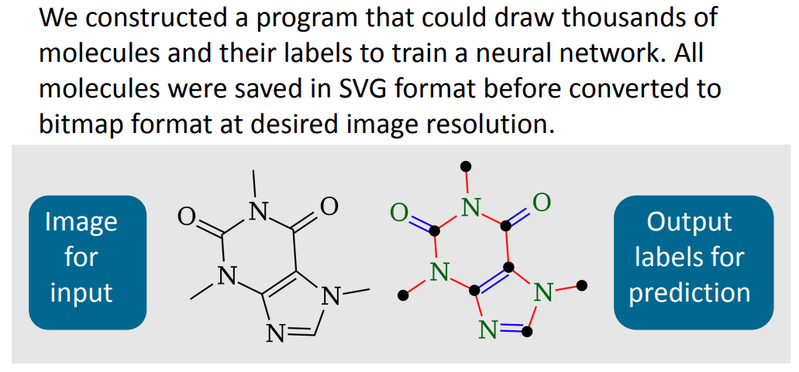
Our group

Slide 30
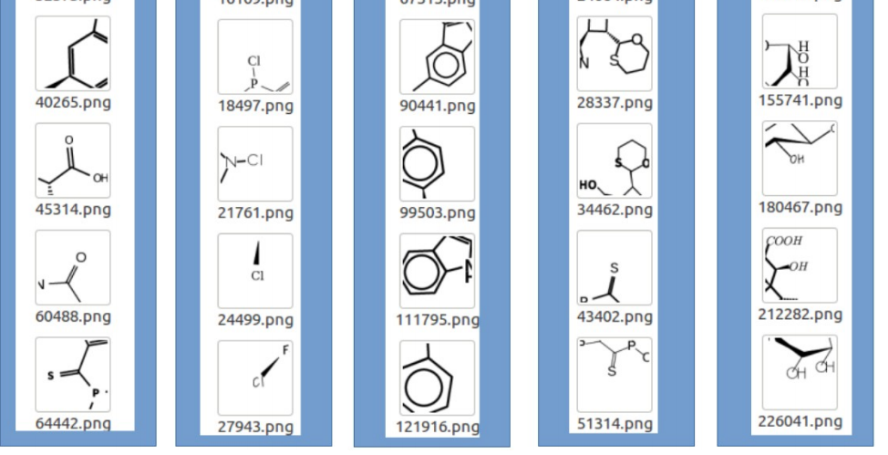
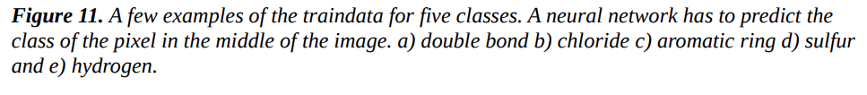
Purely with CNN

Slide 31
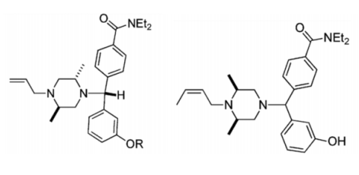
Stakes et al. Molecules wrongly identified in testset:

Slide 32
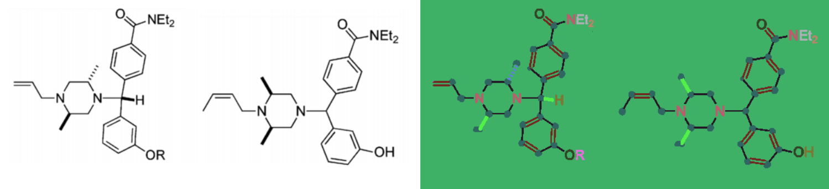
Stakes et al. Molecules wrongly identified in testset:

Slide 33
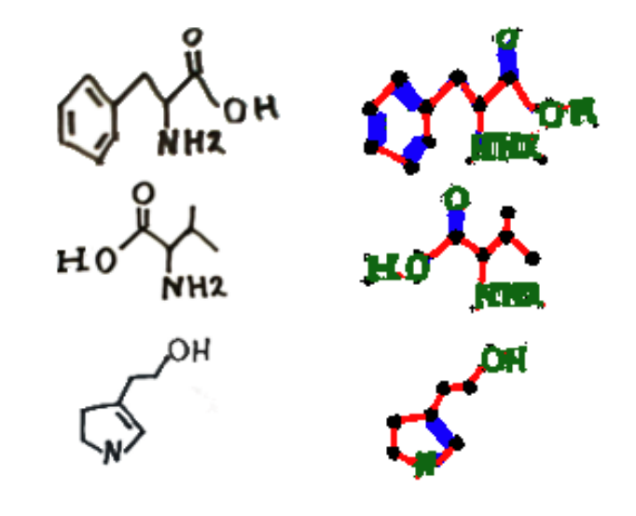
Sometimes even recognize drawn mols

Slide 34
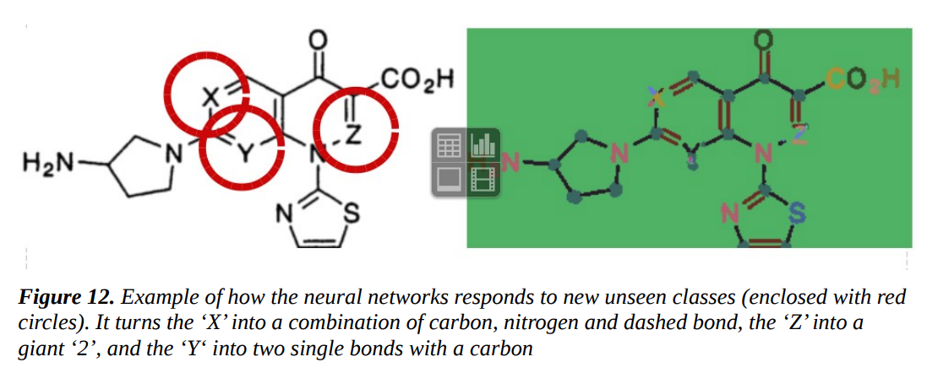
Our failures

Slide 35
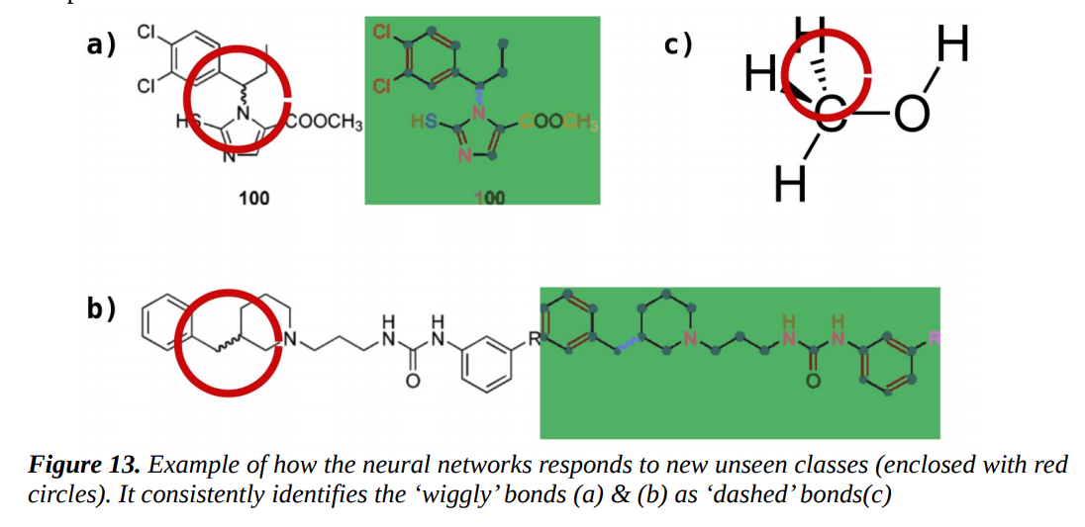
Our failures

Slide 36
Question for you
- Future: Generative
Adversarial Neural Networks (me)
Graph-nets
Cross-entropy (Li)
Question to you:
- What do you want to know more about?

